Slide 1
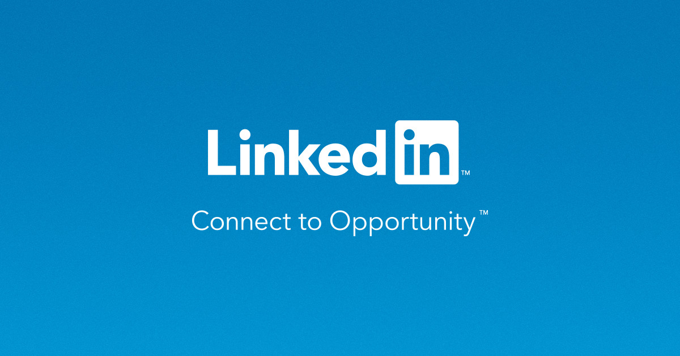
Engagement Project
What is keeping people from contributing?
November 2017

Slide 2

Agenda
The challenge
Reframing the problem
Barriers and detractors for engagement (contribution)
Ideas to mitigate barriers and detractors
Next steps

Slide 3
The challenge

Slide 4
LinkedIn’s Challenge
Design an experience that helps novice contributors overcome the barriers to sharing and target their content to the right audience.
Why is this important to LinkedIn?
A productive content ecosystem relies on a healthy balance of content contributors and consumers that gain and share knowledge.
Notes:
LinkedIn enables professionals to be more productive and successful by helping them stay informed and build meaningful relationships.
A productive content ecosystem relies on a healthy balance of content contributors and consumers that share and learn knowledge about their industries, careers and professional interests.

Slide 5
2. Reframing the problem

Slide 6

Why users are not contributing?
Current
Situation
Internal factors
External factors
Emotion
Technology
Social Norms
Mental Model
Personality
Culture

Slide 7
Why users are not contributing?
Current
Situation
Internal factors
External factors
Emotion
Technology
Social Norms
Mental Model
Personality
Culture

Slide 8
Problems
Emotion
A few emotions commonly associated with using LinkedIn are feeling overwhelmed, inadequate, and exposed
Mental Model
Some users do not view LinkedIn as a “community”, rather they use LinkedIn sporadically throughout their career for very specific purposes

Slide 9
About LinkedIn Users
Emotion
THE GROWING PROFESSIONAL (Primary)
Doesn’t feel empowered and confident to contribute.
Is this contribution valuable?
Is this contribution relevant to others?
Am I being judged?
Am I safe to contribute?
"I take a lot of care on curating what I share."
"You should make an effort to be out there, and participate."
“I need a safe space.”
“Content on LinkedIn is sometimes too unprofessional.”

Slide 10
About LinkedIn Users
Mental Model
THE TASK-ORIENTED USER (Secondary)
Doesn’t find value in consistent engagement with the platform.
Why should I care to use LinkedIn?
Is this content relevant to me?
Why should I contribute?
Will contributing help me achieve my objective?
Would I be judged?
“When I decide to change jobs, I’ll get back on LinkedIn.”
“I don’t have a reason to be on LinkedIn. My [professional] network is at an arm’s reach.”
“There are other sites/apps more relevant to my profession.”
“LinkedIn is a playground for recruiters.”

Slide 11
Engagement goals
Consuming
Reacting
Contributing

Slide 12
3. Barriers and detractors for engagement (contribution)

Slide 13
Barriers/Detractors to Engagement (contributing)
Feeling overwhelmed by too much random content
Feeling inadequate for sharing irrelevant content
Feeling exposed by their actions
Mental model not aligned with value proposition

Slide 14
4. Principles and ideas to mitigate barriers and detractors

Slide 15
Mitigating Barriers to Engagement
Feeling overwhelmed by too much random content
Feeling inadequate for sharing irrelevant content
Feeling exposed by their actions
Mental model not aligned with value proposition
Curation
Empowerment
Control
Motivation
1. Curated Home
2. External Tools
3. Post Requests
4. Micro-contributions
5. Sharing goals
6. Anonymous Posts
7. Targeted Posts
8. Unlock Content

Slide 16
Curated Home Page
Users feel overwhelmed by the amount of content on LinkedIn
Emotions: Overwhelmed
“I already selected which companies, industries, I'm interested in but I keep getting random things on my newsfeed that I don't care about.” -RT
Recommendation:
Provide users with
Simplified curated content on their home page
A space to organize and save content about topics of interest
Notes:
Similar to linkedin pulse digest

Slide 17
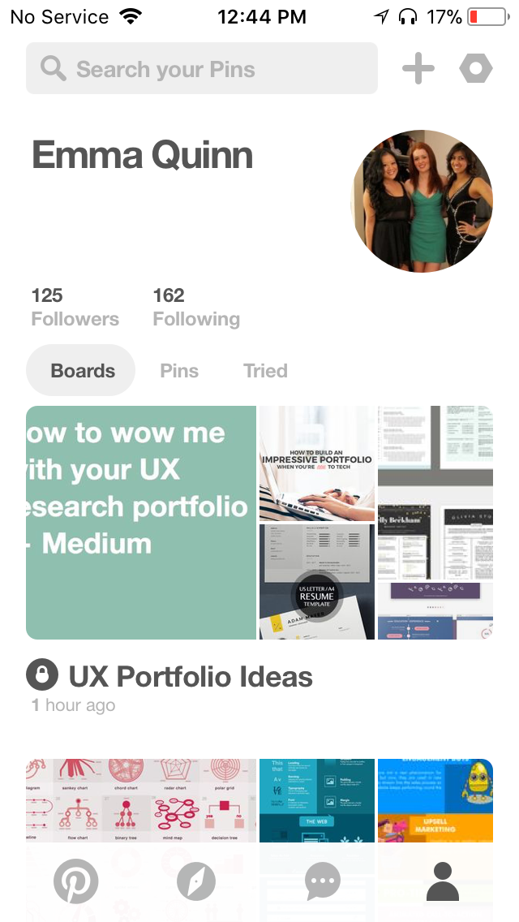
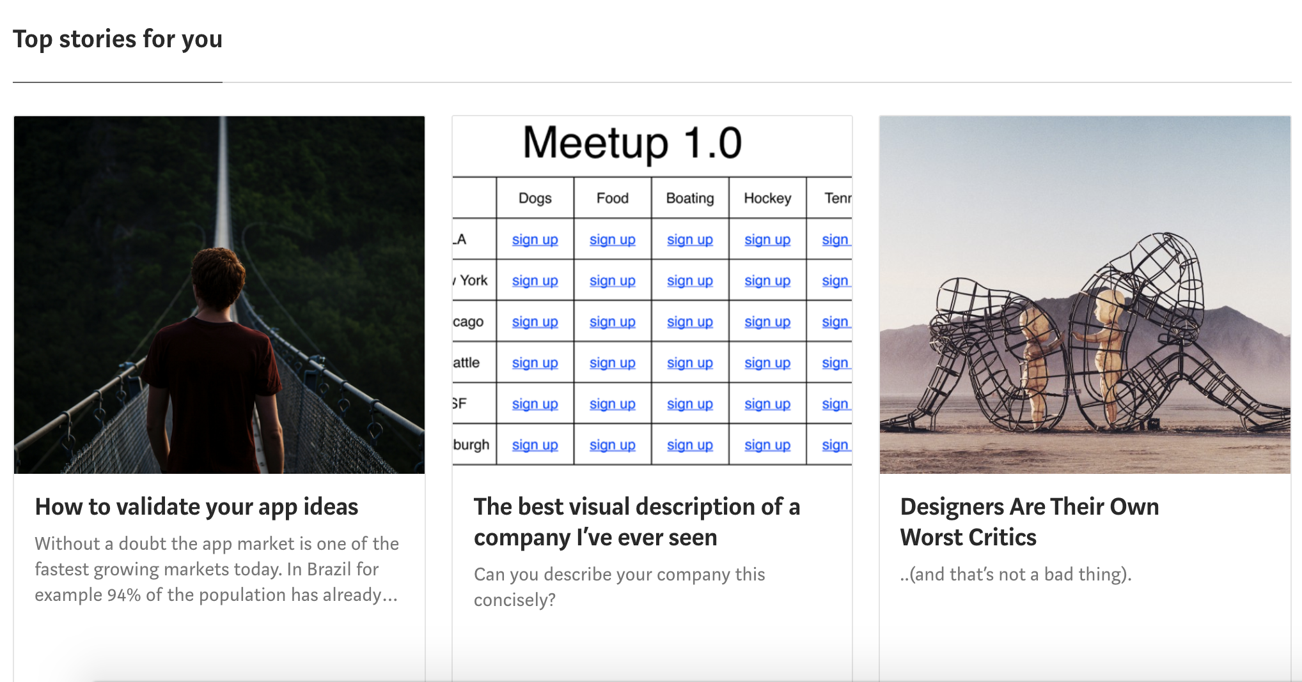
Analogous Experiences
Curated Homepage
Medium home page provides digest of most relevant stories.
Pinterest allows users to curate own content.

Slide 18
Expected Results
Curated Homepage
Users will be able to see content that is tailored to them without being overwhelmed by their feed
Users will spend more time consuming content on LinkedIn.
Notes:
Showcase features: Linkedin Learning, pro finder

Slide 19
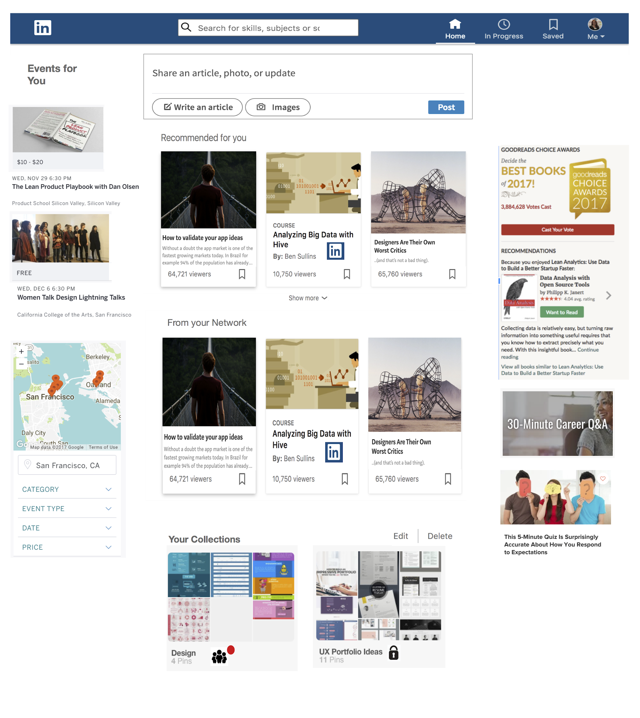
Curated Home Page
Event Recommendations
Micro-Contribution Opportunities
-Voting
-Quizzes
-Q&A
Content curated for user each day
Content from network (feed like)
Users saved collections
(secret or community)

Slide 20
2. External Tools & Applications
Users want more control over how their feed is curated.
They want to be confident their posts are reaching the correct audience.
They don’t always see LinkedIn as a source for information or a place to spend time.
How can we encourage more engagement and help users feel less overwhelmed?

Slide 21
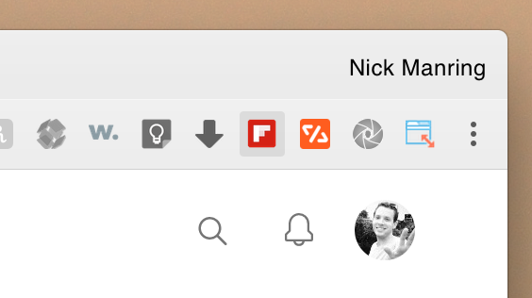
Analogous Experiences
External Tools & Applications
Flipboard is a news aggregator that can be used via website, app, as well as browser extension. Articles can be bookmarked for later reading as well as added to curated “magazines” that others on the platform can subscribe to. They also have “smart magazines” that curate articles for you.

Slide 22
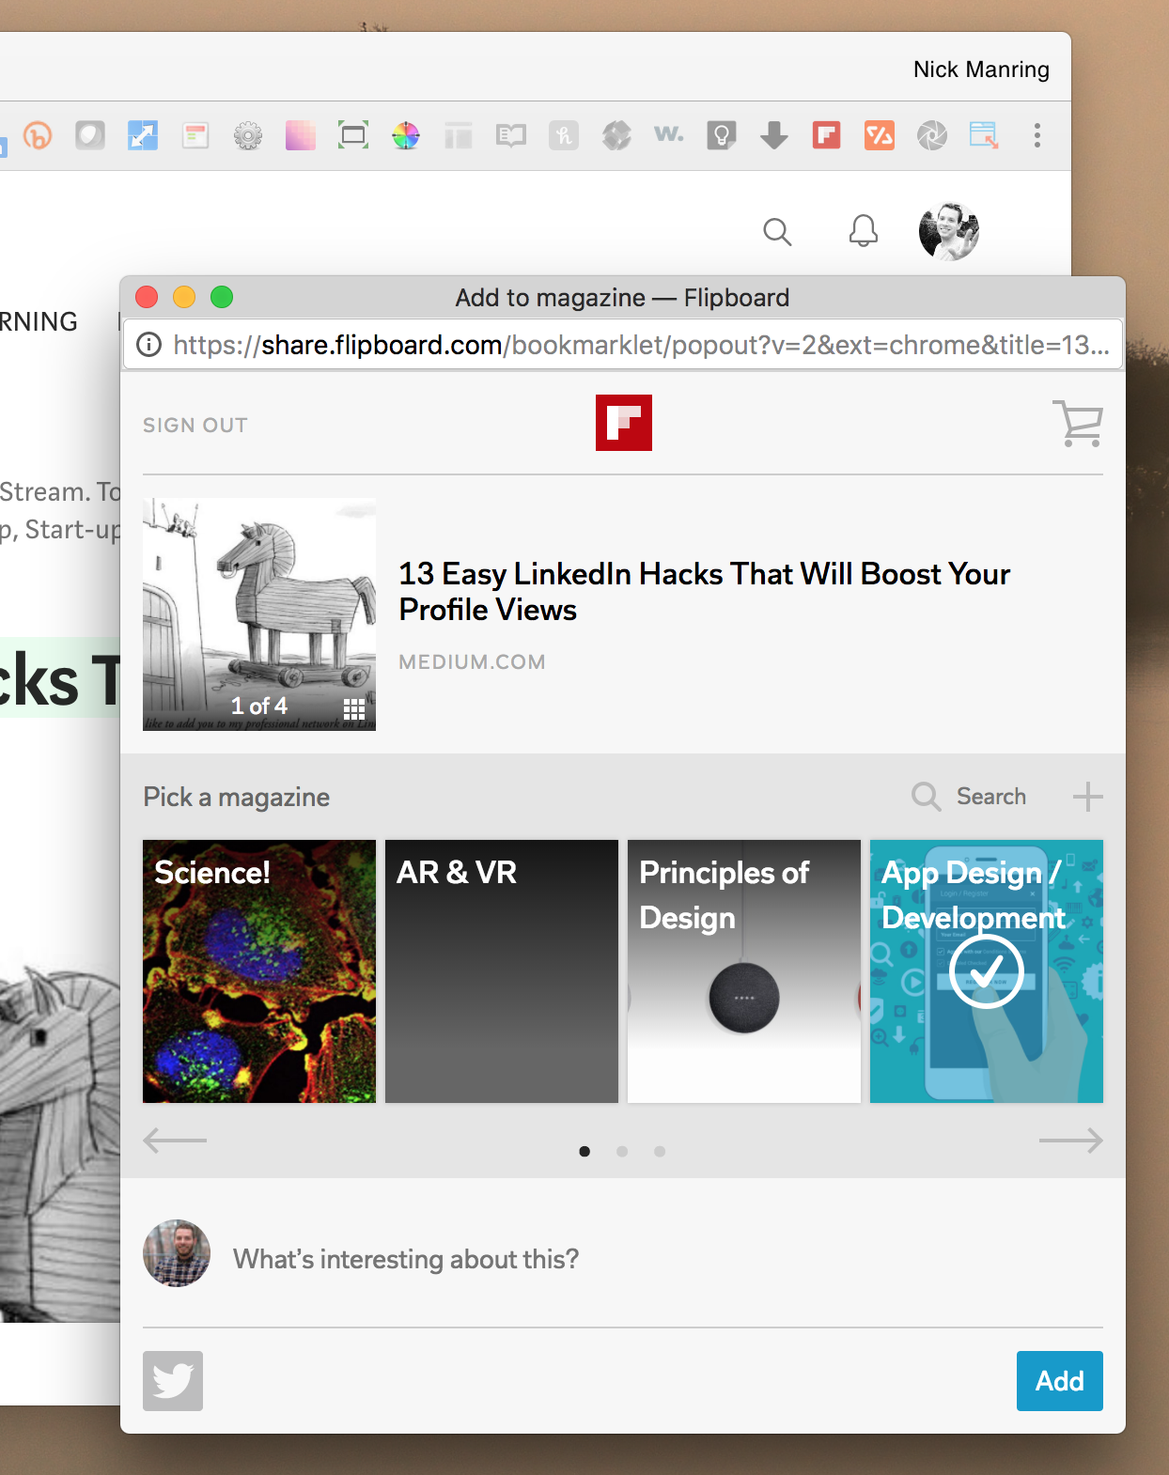
External Tools & Applications
Browser extensions let users do two things very well
They let the user engage with the platform from outside the site
They make it easier and faster to do those things, including sharing, curating and posting.
Currently, the LinkedIn extension takes you to LinkedIn when you have notifications.
Keeping users where they are without interruption will start to breakdown their mental model of what LinkedIn is. They don’t have to “go” there anymore. It is a part of their normal browsing experience.

Slide 23
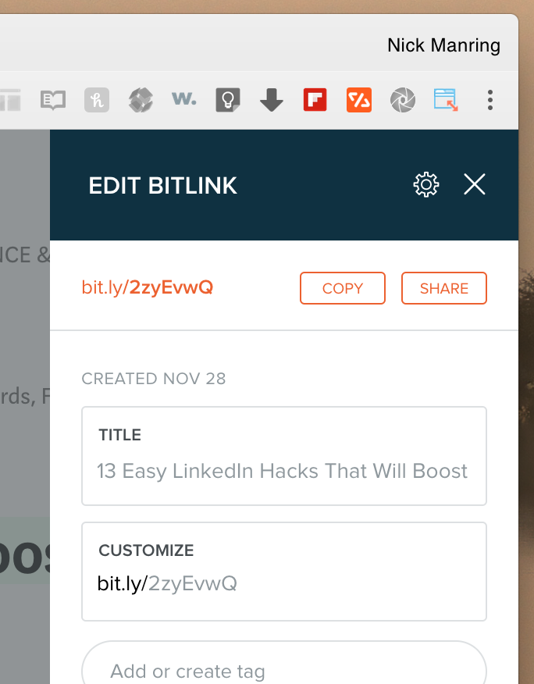
External Tools & Applications
Bit.ly is another website who is using browser extensions to make it easier for user to use their platform.
Making it easier for users to share, consume, or react to content outside of a website expands the reach of that platform’s experience.
Bit.ly is a link management platform that it allows you to customize the URL of a hyperlink and track the click-rates on your shared links.

Slide 24
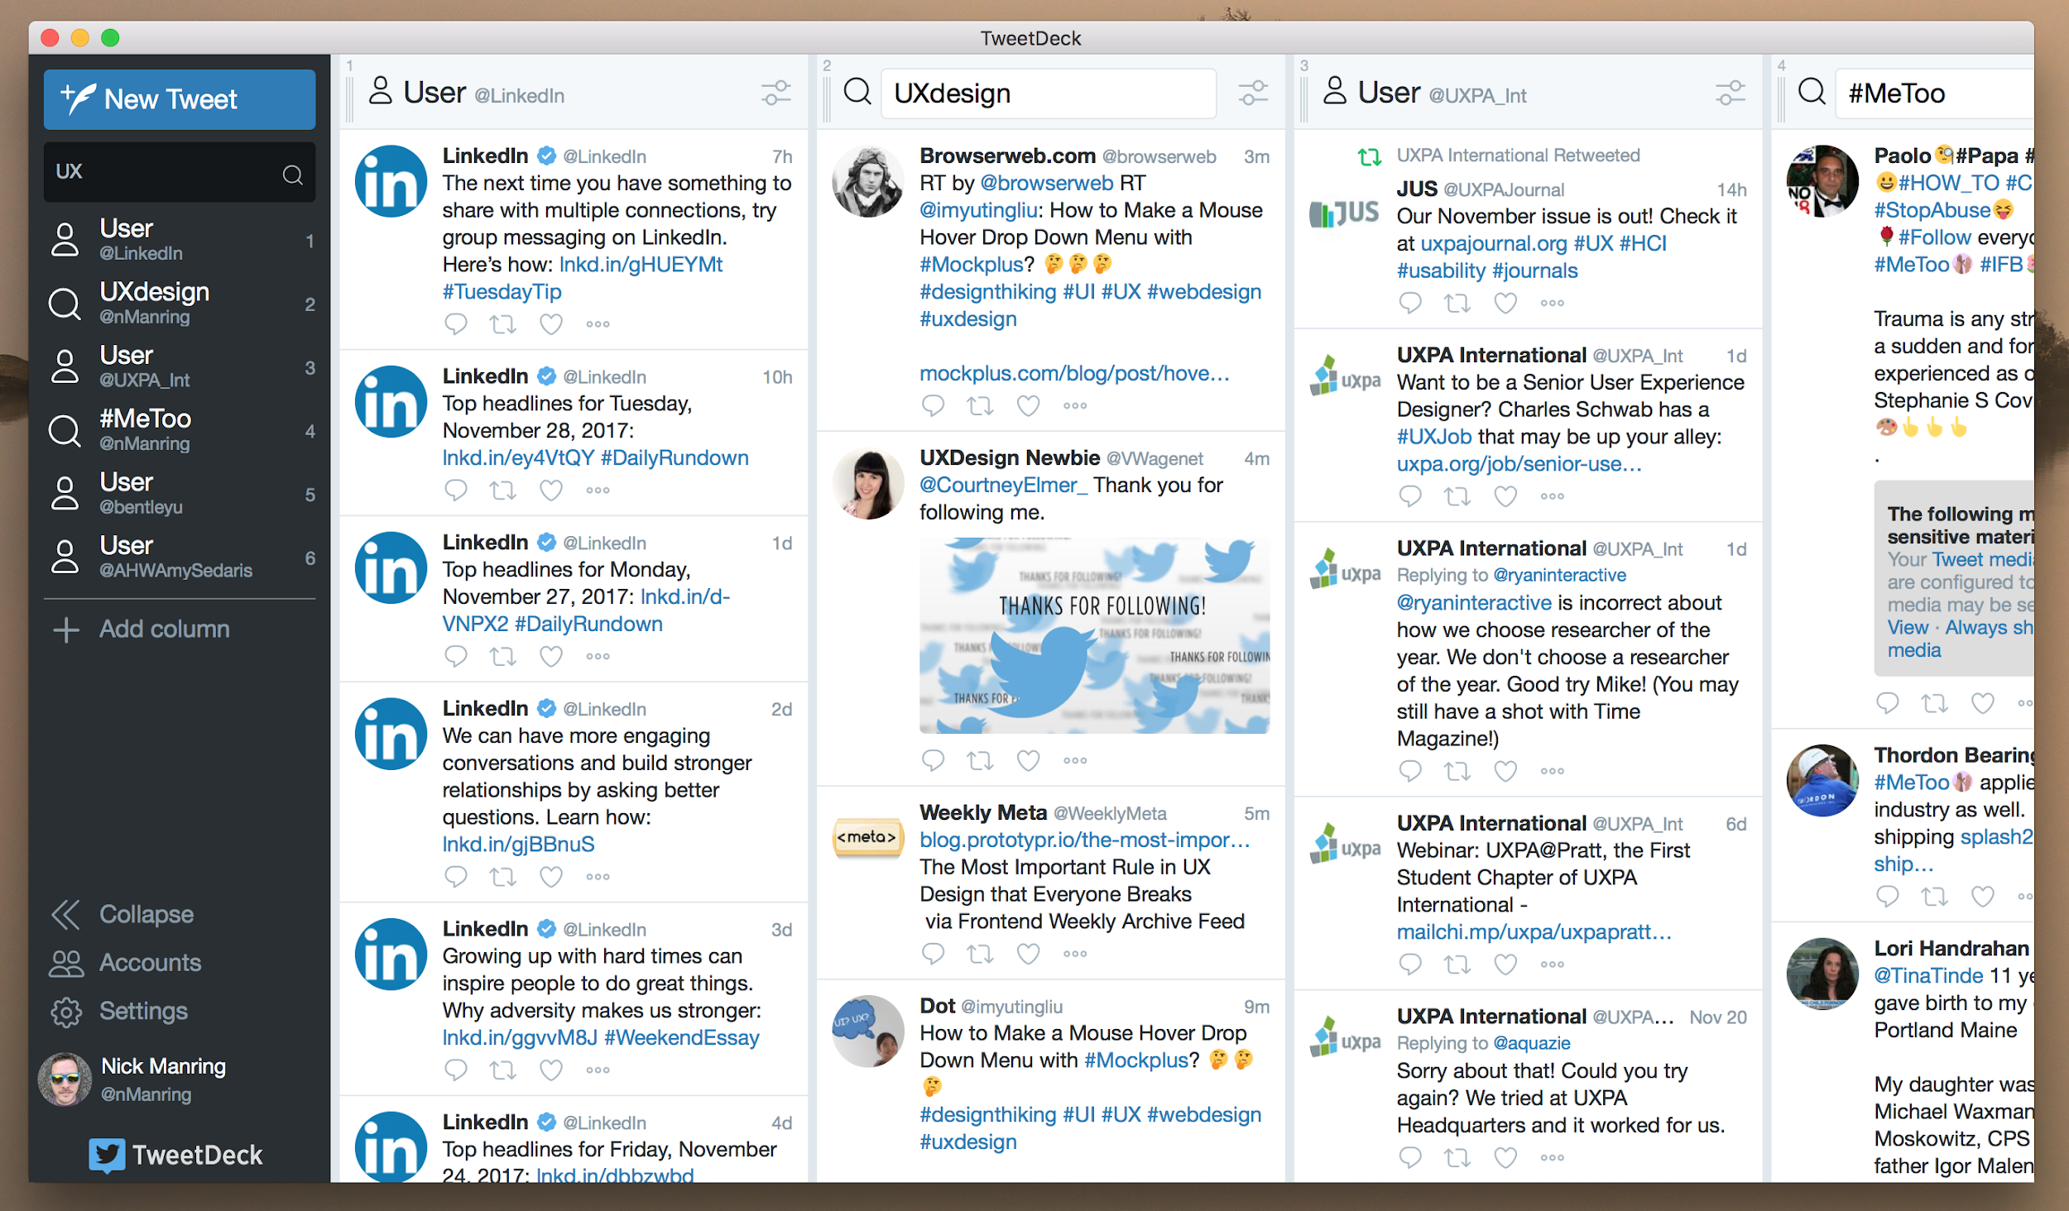
Analogous Experiences
External Tools & Applications
TweetDeck is an application for desktop computers and tablets which lets Twitter’s users track multiple feeds based on people, businesses, or trending topics.

Slide 25
Analogous Experiences
External Tools & Applications
This tool was not owned by Twitter at first. It was acquired by the social media giant in 2011.
This information management tool was clearly very effective in aiding users’ consumption of content and became very popular because of it.

Slide 26
Expected Results
External Tools & Applications
Take users outside the space they are used to to break down mental models.
Make it easier for users to share and post.
Give them the tools to curate what they feel is meaningful and direct it towards an audience who cares.
By adapting the current browser extension to allow users to post and fully adopting a separate tool for consumption, LinkedIn can break down many obstacles restricting engagement.

Slide 27
3. Post Requests
Users sometimes feel paralyzed by the desire to post valuable content.
Emotions: overwhelmed/ feeling inadequate
“When I feel like it’s not something I’m going to do well in, I won’t start.”-BO
“I don’t have any feedback to know if it’s ok.” -BO
“I want to post things that are relevant to my network” -HY
Recommendation: Implement a post request feature that will allow users to nominate others to post about useful or in-demand topics.
Post requests will inspire users to post because they’ll know what topics people find useful.
Growing Professionals and Task Oriented Users will feel empowered by the encouragement of others.

Slide 28

Analogous Experiences
Post Requests
Ice Bucket Challenge participants nominated others to participate in challenge.
Challenges create “healthy” peer pressure.

Slide 29
Expected Results
Post Requests
Users will be “nudged” to post by the encouragement and “pressure” of others.
More posting will produce a more active community, which will then inspire other less engaged users (task-oriented) to post.

Slide 30
4. Micro-contributions
Users sometimes feel LinkedIn is a very professional space.
Mental model: Only for recruiting/look for a job
"I never engage with any content on Linkedin, I never ever read the feed." -RT
“"I see it as a recruiter's playground." -FS
Recommendation: Create spaces for users to interact and participate. Ie. Quizzes, trivias, polls, giveaways...
This can be a fun way to engage while receiving valuable content.
Growing professionals might see this as a tool to participate and learn something new about themselves or others.

Slide 31
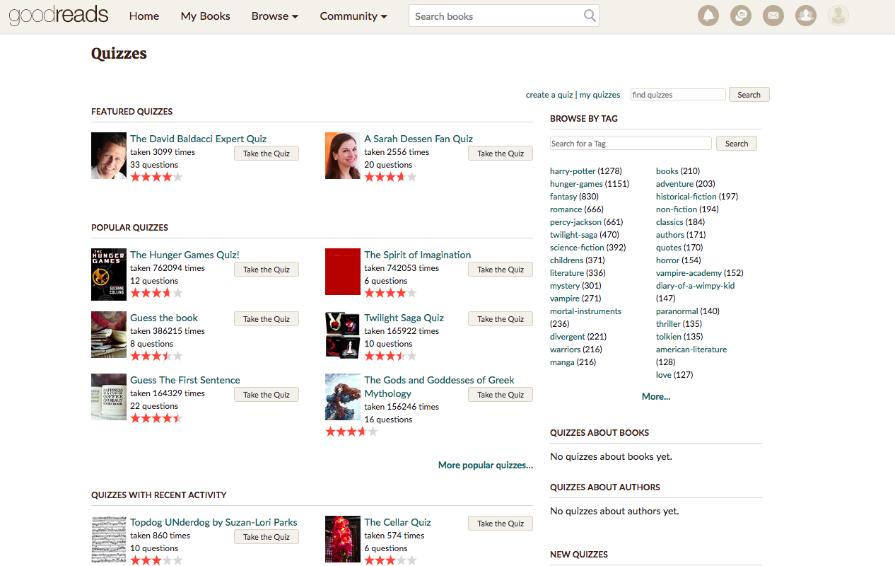
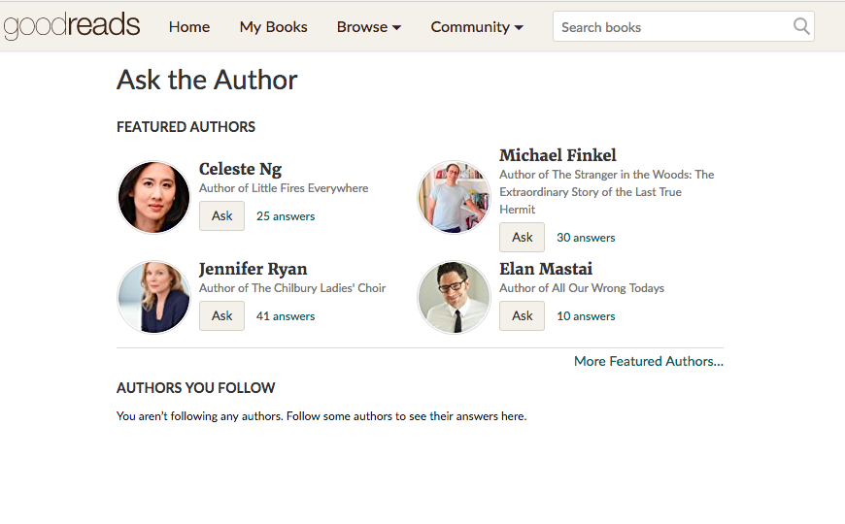
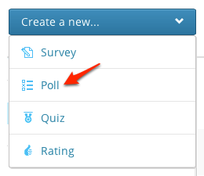
Analogous Experiences
Micro-contributions
Quizzes like “What is your communication style?”, or forums like “Ask the author” are easy to engage with, while being relevant for the users.

Slide 32
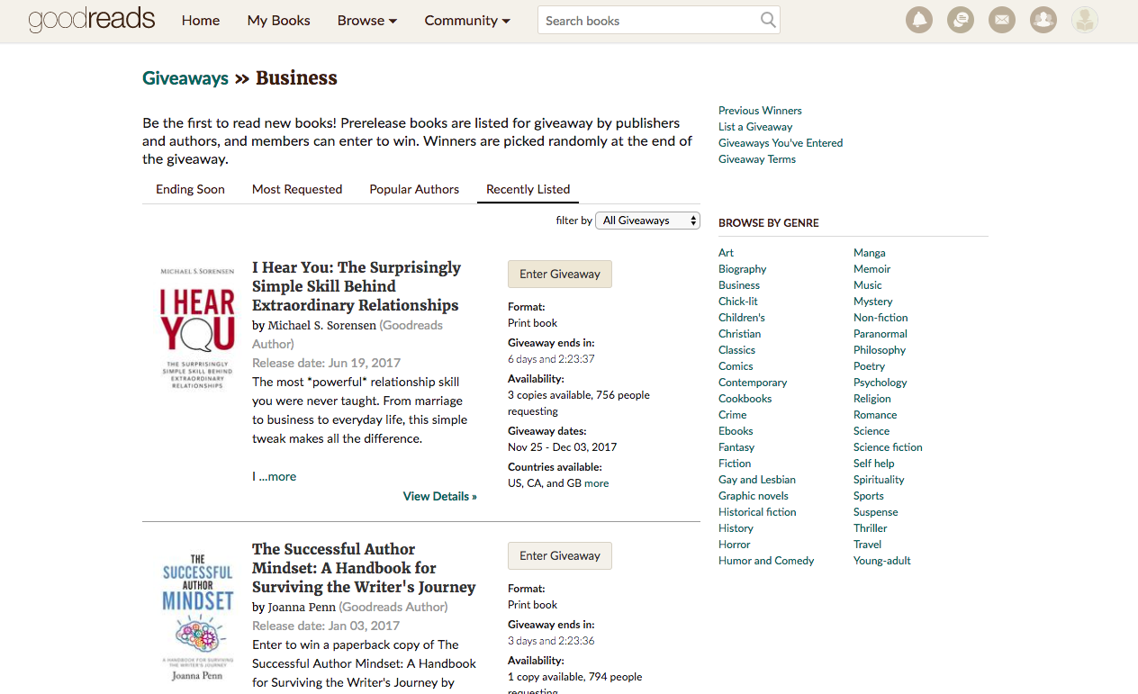
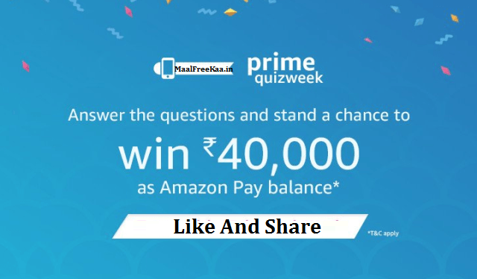
Analogous Experiences
Micro-contributions
Giveaways can be a business opportunity for sponsors to deliver specific goods or content (ie. courses, resumé analysis, etc).

Slide 33
Expected Results
Micro-contributions
Users start interacting more while receiving valuable content.
Other users will feel curious about their connection’s results and therefore engage or give it a try as well.

Slide 34
5. Professional goals
Users sometimes have a desire to stand out and share their accomplishments.
Emotions: feeling inadequate
“I grow as a professional by taking new challenges at work.”-MSL
"I love congratulating people on their new positions :) I think is a great achievement I feel excited about it. I think is really cool, it's an important part of one's life and I feel very proud of my network." - RT
“I share results of my professional career." -MC
Recommendation: Let users make professional goals public, and achieve milestones during the year.
Growing Professionals and Task Oriented Users can feel motivated by others’ encouragement to reach their goal.

Slide 35
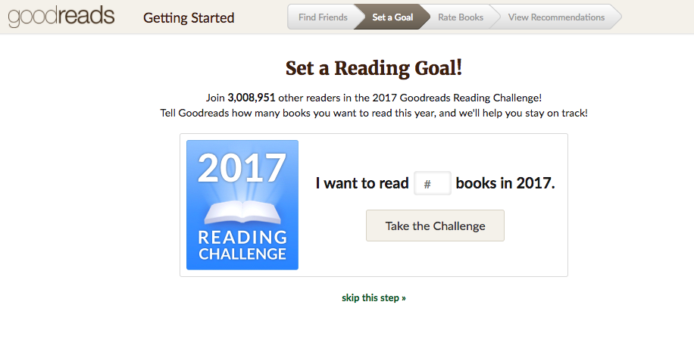
Analogous Experiences
Professional goals
In Goodreads setting a reading goal would make a person more likely to achieve it.

Slide 36
Expected Results
Professional goals
Users might feel more compelled to achieve them and therefore come back regularly to update public status.
LinkedIn could also encourage the user to reach the user’s goal.

Slide 37
6. Anonymous Post
Users sometimes feel they’ll be judged by the content they post.
Emotions: Exposed
“I don’t want my boss or future boss to judge me.”-MS
“I’m not confident enough to post. Will start posting after I have gained more experience and knowledge.” -TP
Recommendation: Allow users to post content anonymously with an option to reveal their identity any any given point of time.
This will make users feel more secured, thus boosting their confidence and motivating them to post more.

Slide 38
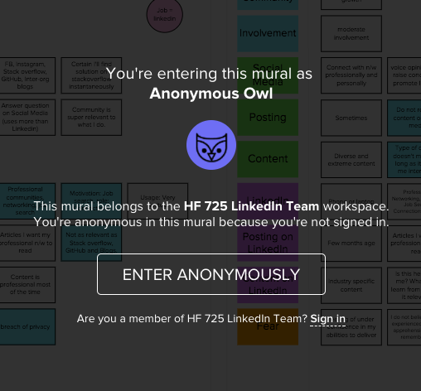
Analogous Experiences
Anonymous post
Mural allows users to post anonymously. Thus, giving opportunity and comfort to the users who don’t like to shout-out ideas or opinions.

Slide 39
Expected Results
Anonymous post
As users start getting more likes and comments on their anonymous post, they will feel confident which can lead to posting of more content.

Slide 40
7. Targeted Posts
Users sometimes feel they are not qualified enough to post content.
Emotions: Inadequate
“At this point in my career I don’t think I’m in a position to write or share domain specific content.”-TP
“I’m not sure if people will find my content relevant” -MS
Recommendation: Allow users to target their posts to specific users or groups.
This will help users overcome their feeling of inadequacy and incompetence.
This will also make users feel more secured and confident.

Slide 41
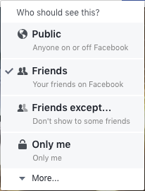
Analogous Experiences
Targeted posts
Facebook allows users to to choose who can view their posts.

Slide 42
Expected Results
Targeted posts
More secured and relevant postings will help engage content contributors as well as consumers.
Targeted content from a known contributor (friends, colleagues, family) will help invoke a sense of belonging and promote content relevance.
Also, Content consumers will feel privileged and will be obliged read since the content is specifically targeted towards them.

Slide 43
8. Unlock Premium content
Users sometimes feel shared content is superficial.
Emotions: Overwhelmed
Mental Model: Get more benefits
"You grow when getting to know best practices in the business." -RT
"You grow listening to standard setters." - RT
“I usually look at content originated from sources, other than my friends.” -AM
Recommendation: If users can receive guides, samples, or exclusive information for their benefit, they might feel in debt and “pay back”.
Reciprocity “first give in order to receive”. You give your “post”, “share”, “reaction” in order to unlock the content.
Growing Professionals can see value in guides, standards and reports that will help them discover new insights.

Slide 44

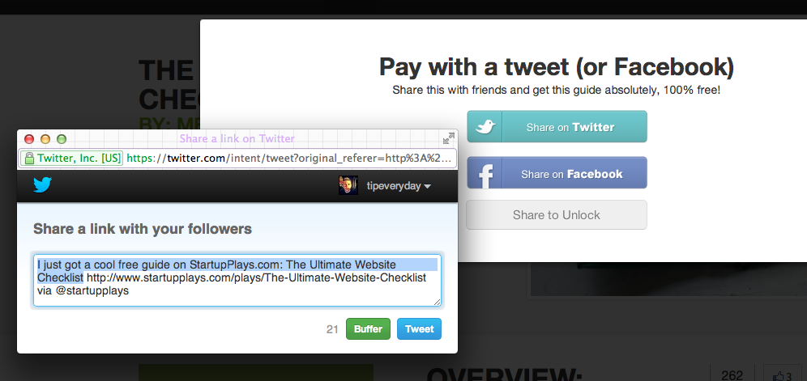
Analogous Experiences
Unlock Premium Content
Pay with a Tweet enables paying back with virality instead of money.

Slide 45
Expected Results
Unlock Premium Content
Users start sharing suggested content. Virality of posts might increase.
A database of user interests could be obtained.

Slide 46
Wrapping up - The Complete Engagement Ecosystem
Feeling overwhelmed by too much random content
Feeling inadequate for sharing irrelevant content
Feeling exposed by their actions
Mental model not aligned with value proposition
Curation
Empowerment
Control
Motivation
1. Curated Home
2. External Tools
3. Post Requests
4. Micro-contributions
5. Sharing goals
6. Anonymous Posts
7. Targeted Posts
8. Unlock Content

Slide 47
5. Next Steps

Slide 48
We suggest
Conducting more detailed research to in order to:
Gain more insights
Prioritize ideas
Check feasibility of each idea
Notes:
Similar to linkedin pulse digest

Slide 49
Team
Nick Manring nmanring@gmail.com
Sandra Perdomo sperdomo456@gmail.com
Emma Quinn emjquinn7@gmail.com
Andrea Cantú canturo_andr@bentley.edu
Pratik Gami pratikgami@gmail.com

Slide 50
Appendix
Notes:
Events page ($$$)

Slide 51
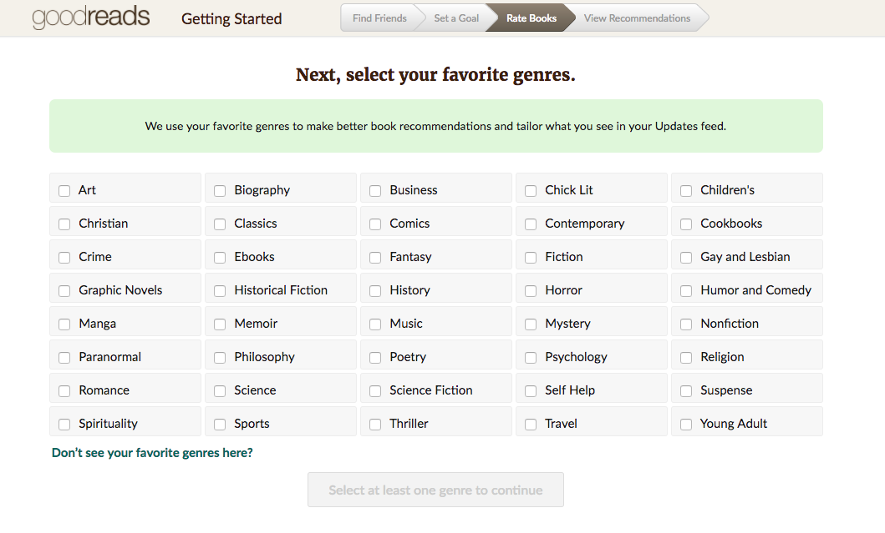
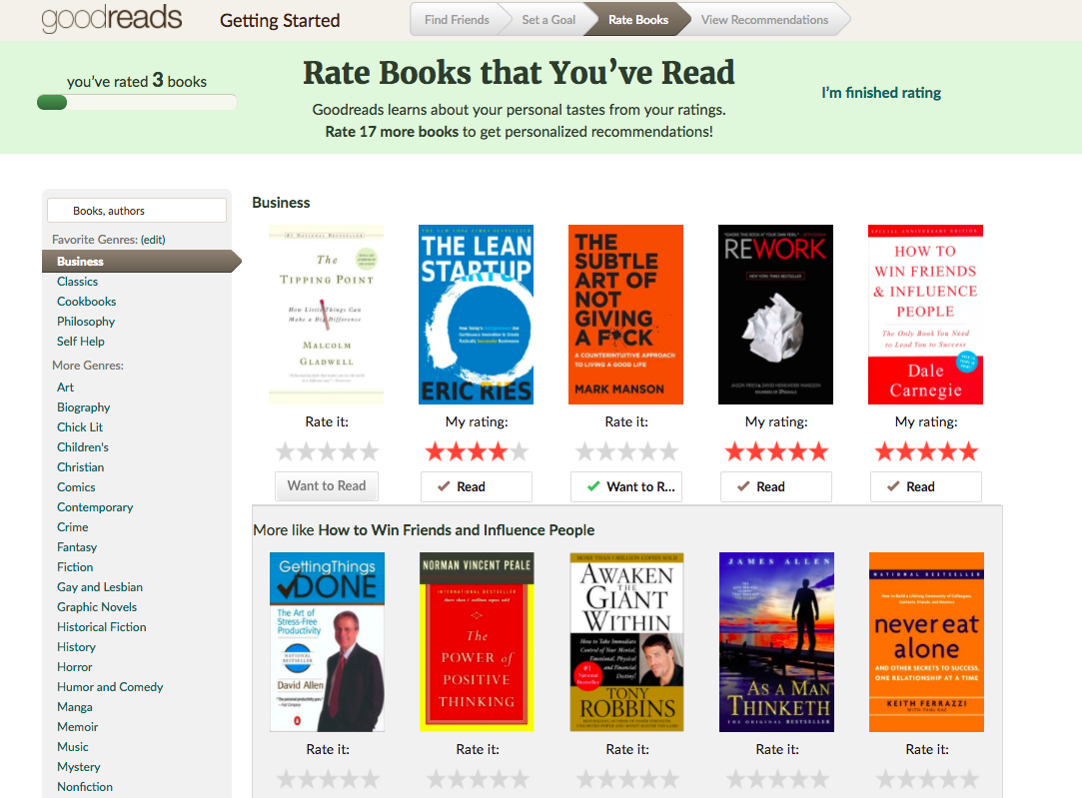
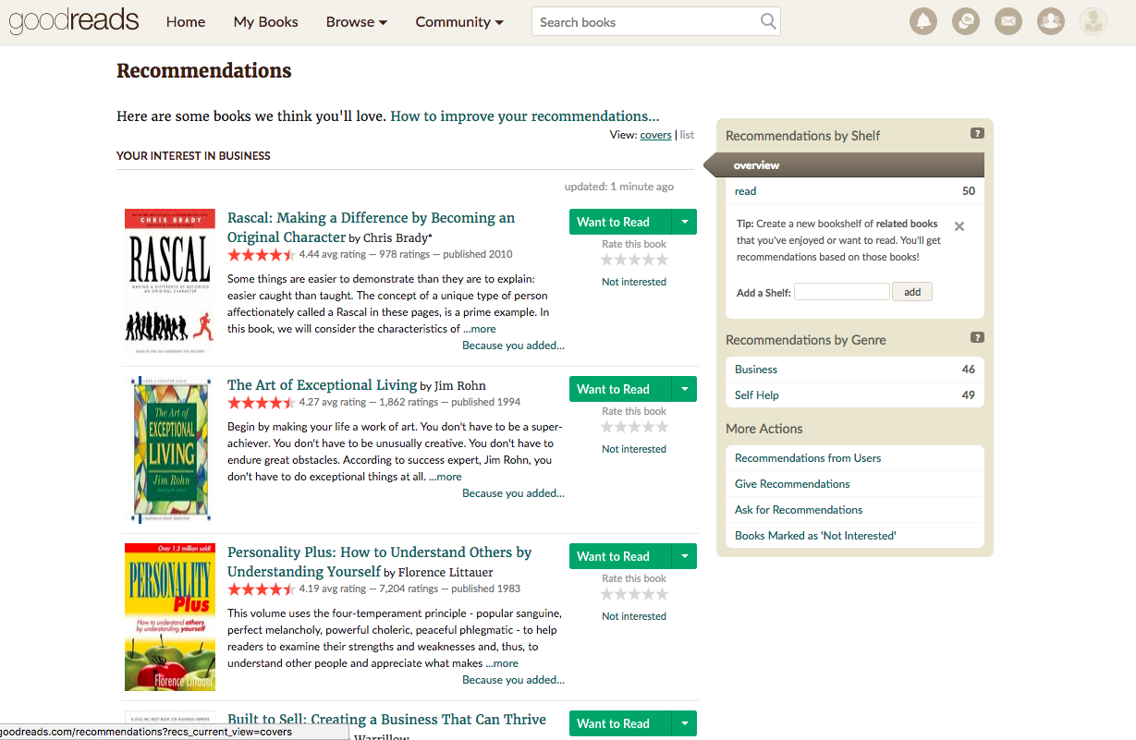
More ideas on subtle curation
Notes:
Similar to linkedin pulse digest

Slide 52
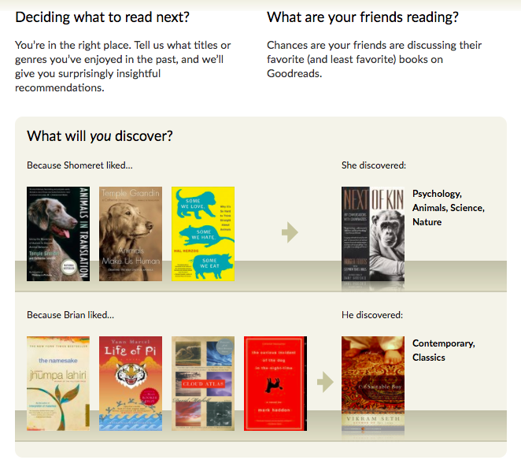
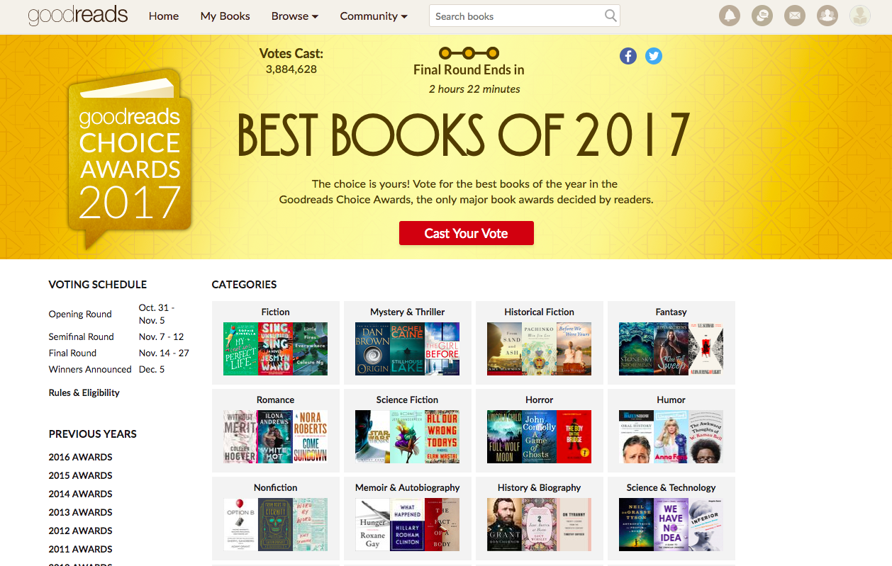
More ideas on subtle curation
Notes:
Similar to linkedin pulse digest

Slide 53
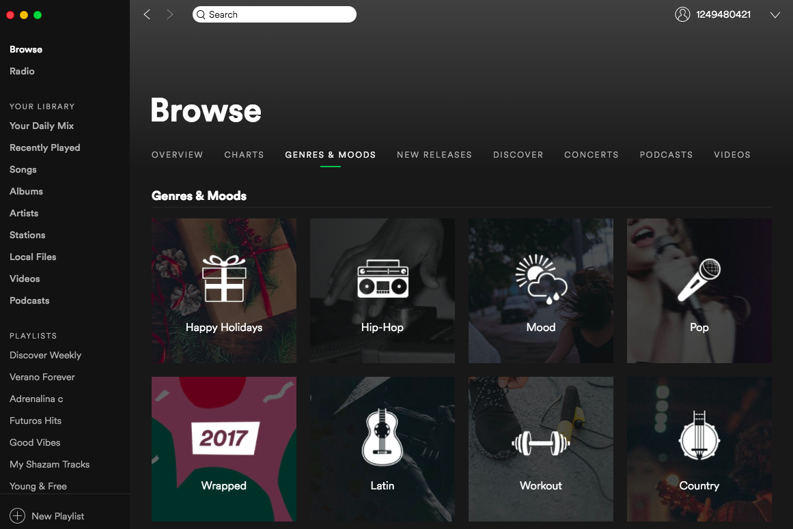
More ideas on subtle curation
Notes:
Similar to linkedin pulse digest

Slide 54
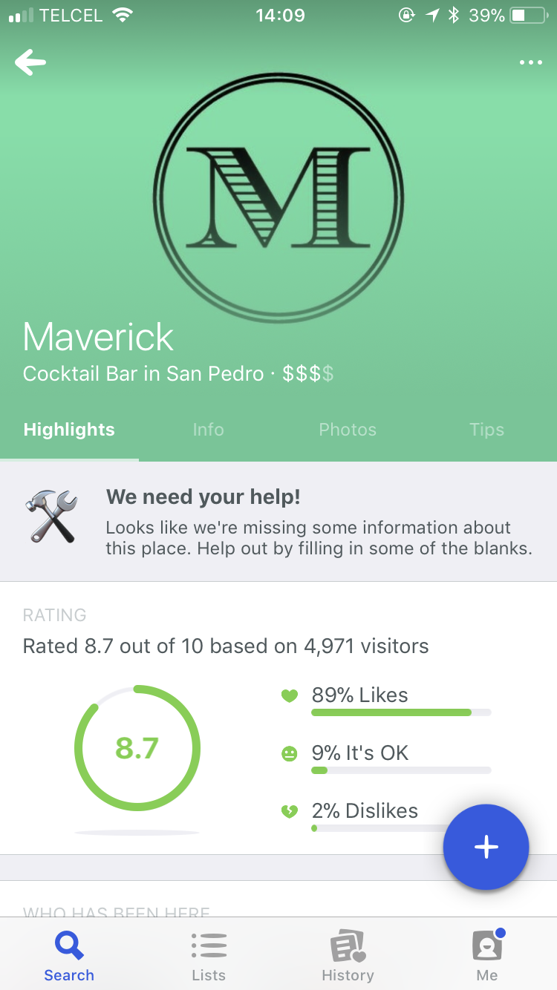
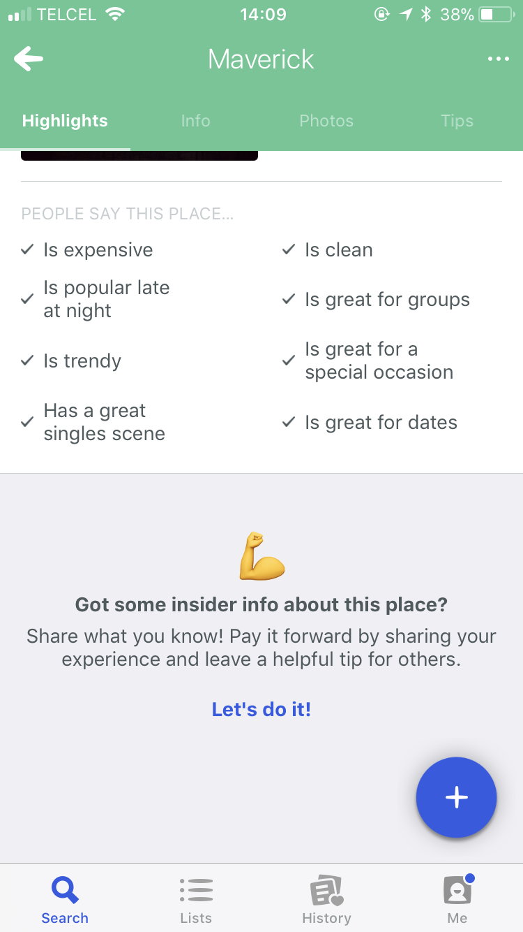
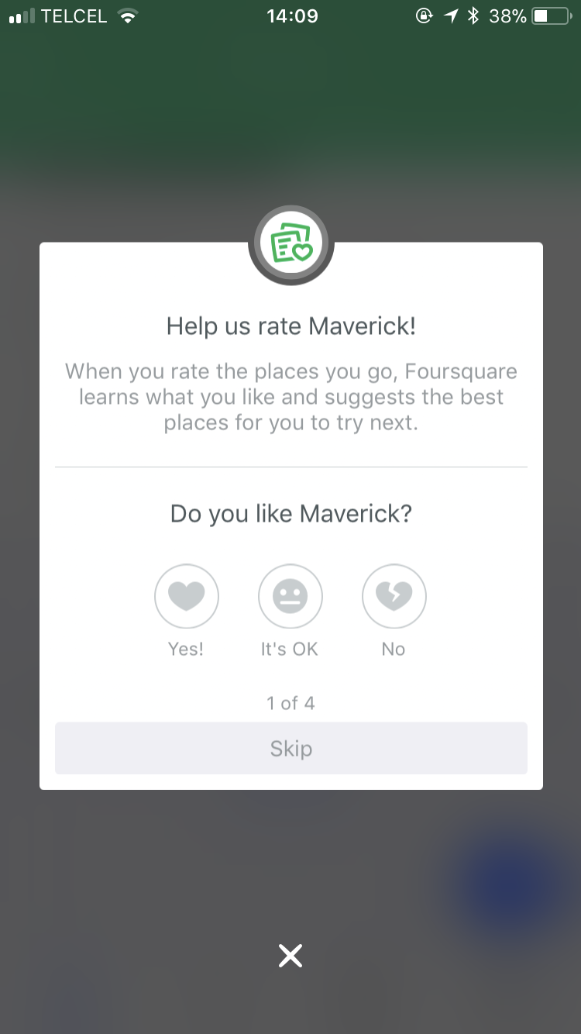
More ideas on subtle curation
Notes:
Similar to linkedin pulse digest

